Slide 1
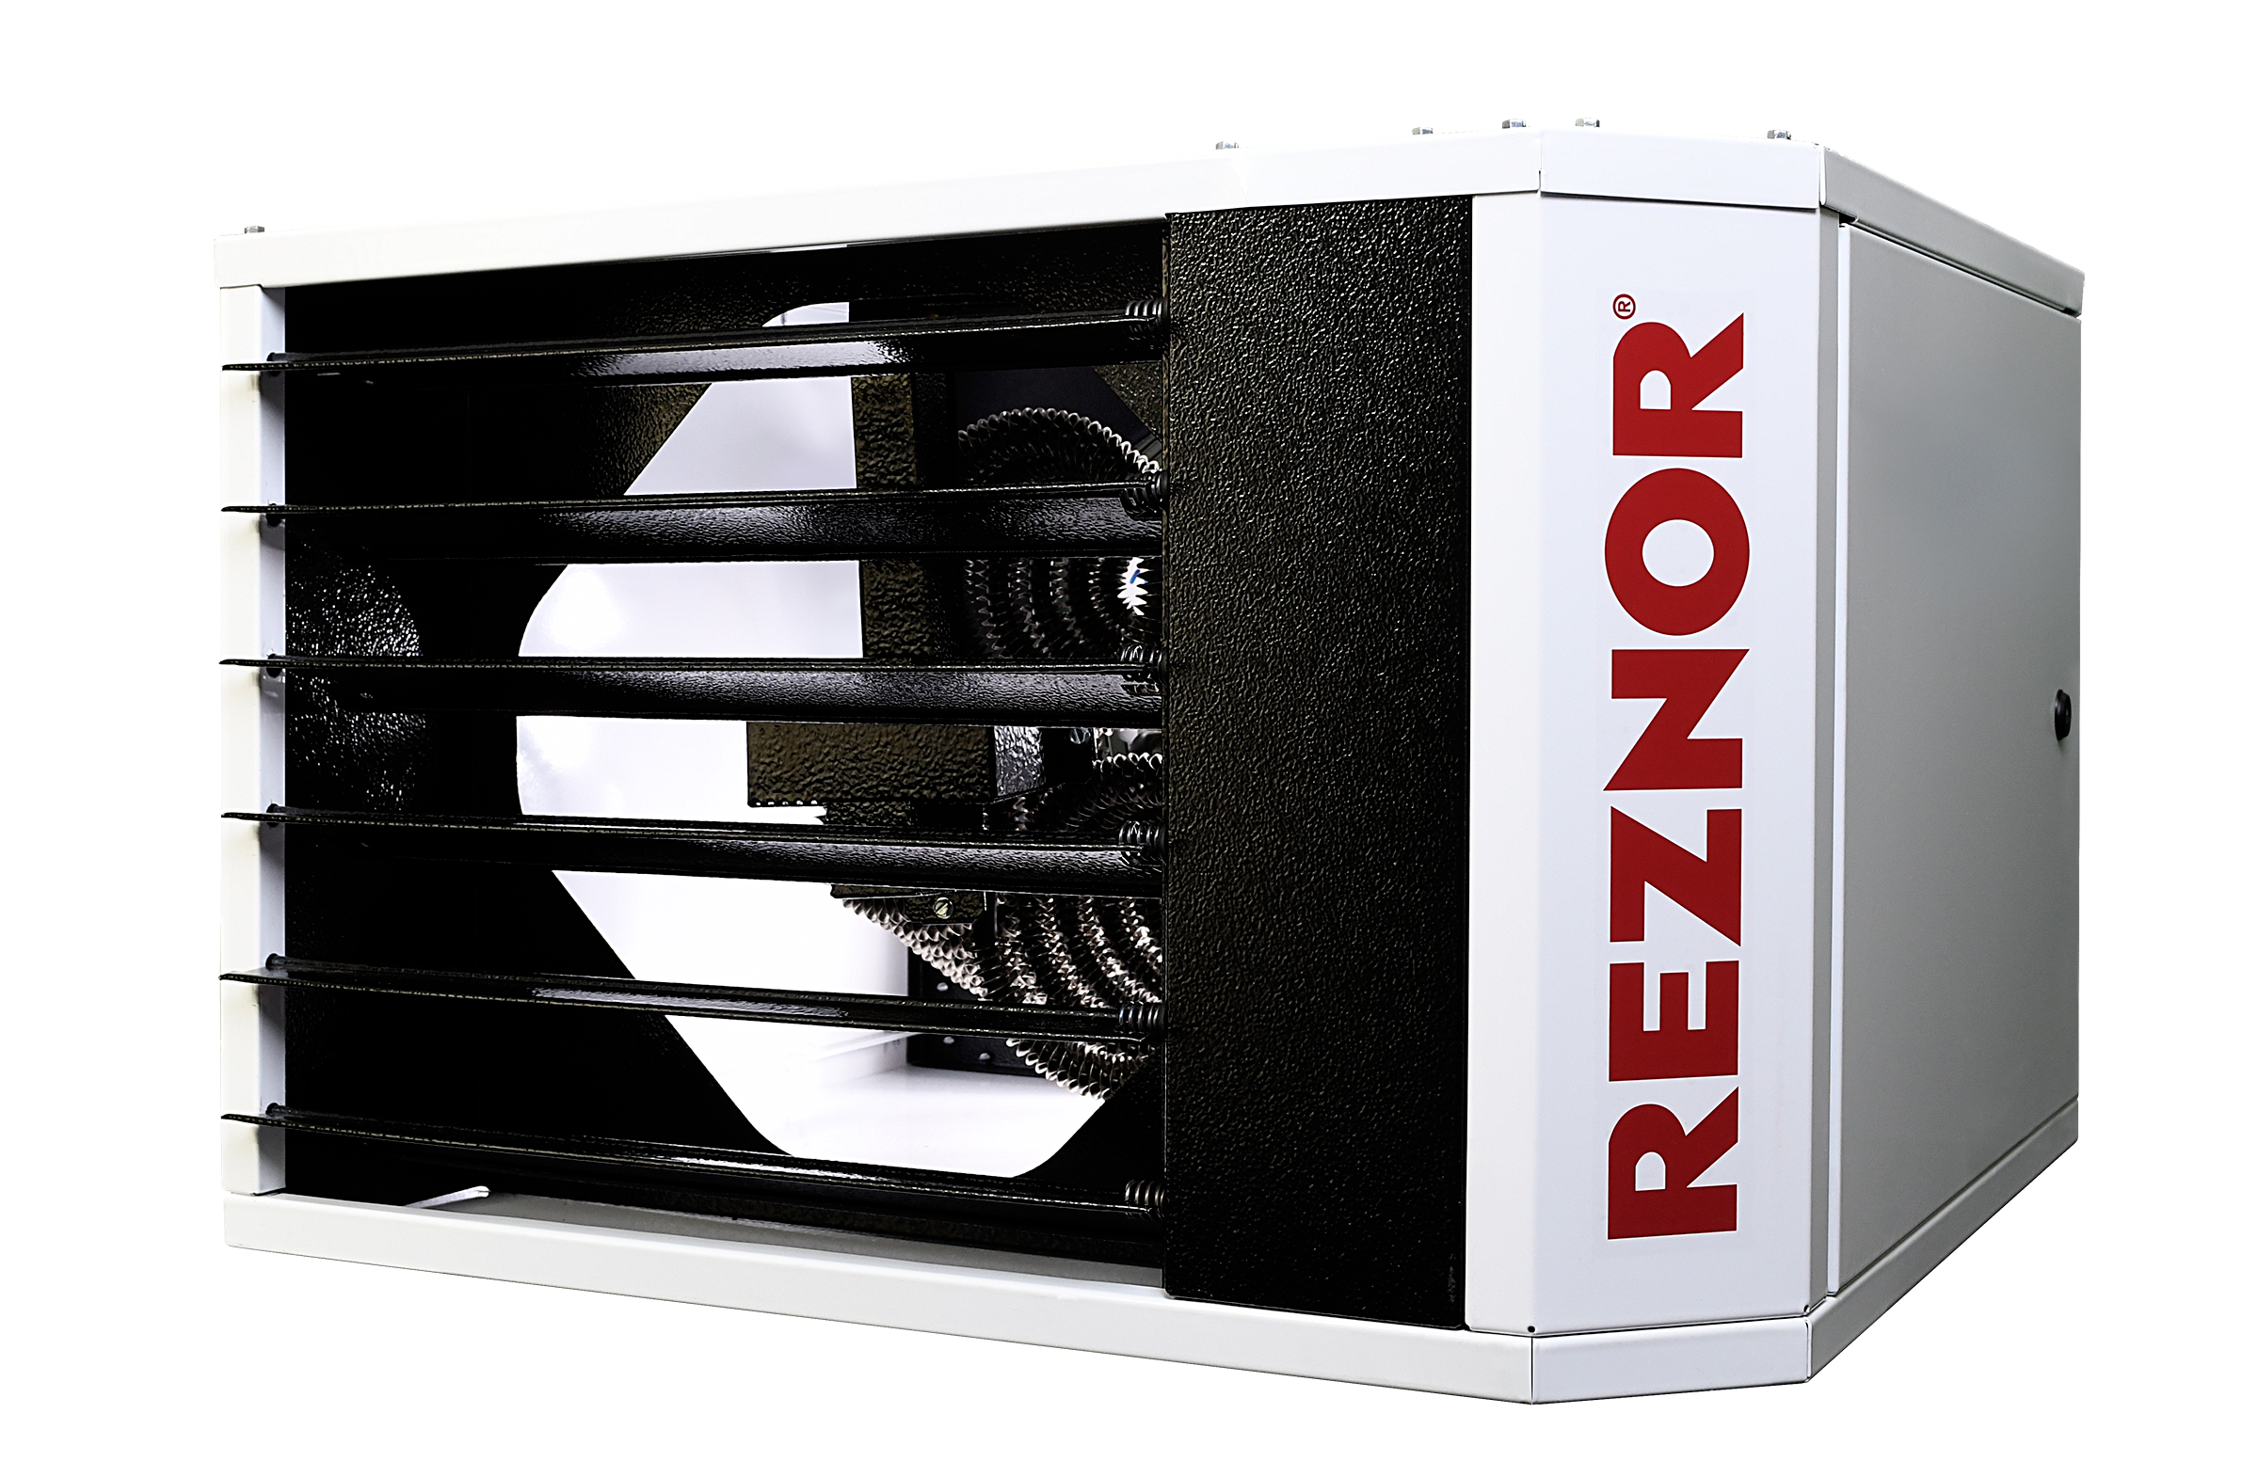
EUH Series
Electric Unit Heaters

Slide 2
Agenda
Why Electric Unit Heaters?
  Market Drivers
Reznor EUH Series Electric Unit Heaters Introduction
  Product Offering
  Product Specifications & Dimensions
  Selection and Sizing
  Controls
  Installation
  Unique Features
  Ideal Applications
  Literature Availability
  Product Availability
    EUH Phase in
    EGEB/EGHB Phase-Out Plan
  ACE Setup
Bringing the Heat since 1888

Slide 3


Market Drivers
Decarbonization
Renewable electricity replacing natural gas & propane
Gas unit heater replacement with alternates inevitable
Energy Efficiency
100% heating efficiency
Building energy efficiency requirements
Single Source
Minimize confusion on the job
Single professional look for the job

Slide 4
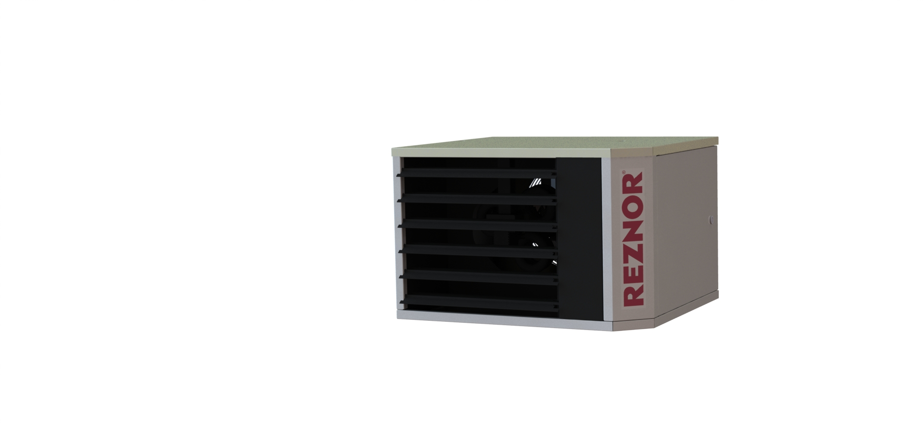
Product Specification
Develop 8 capacities in 3-30 kW = 97% of Sales
  Retain EGHB 40-60 kW to satisfy need
5 voltages required = 90% of Sales
Incorporate 208-240/1-3 in 1 unit for 3-10 kW models
Physically appear similar to Reznor Unit Heaters
Incorporate external input controls (BMS)
Two-Stage Heat for larger models
Product Differentiators:
  4 voltage in 1 sku eliminates distributor stocking reluctance
  Incorporate ability to control Destratification Fans and Unit Heaters (Gas and/or Electric) from same thermostat
    Offered on Gas UH now, extend to EUH

Slide 5
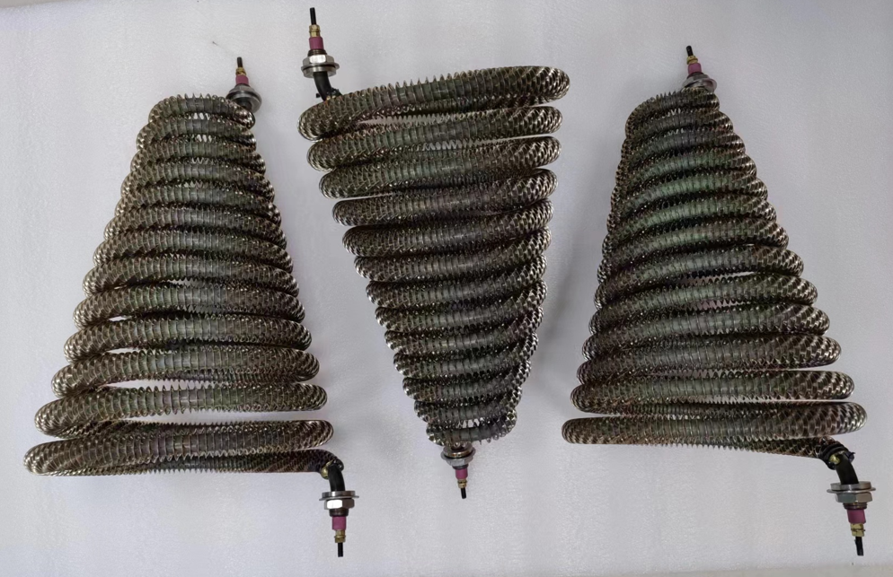
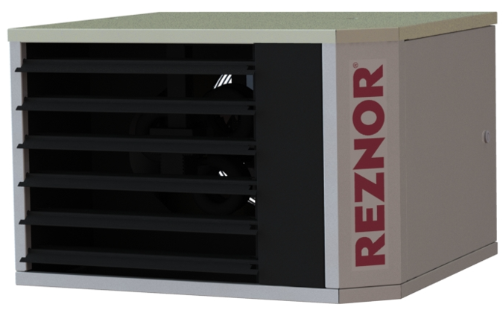
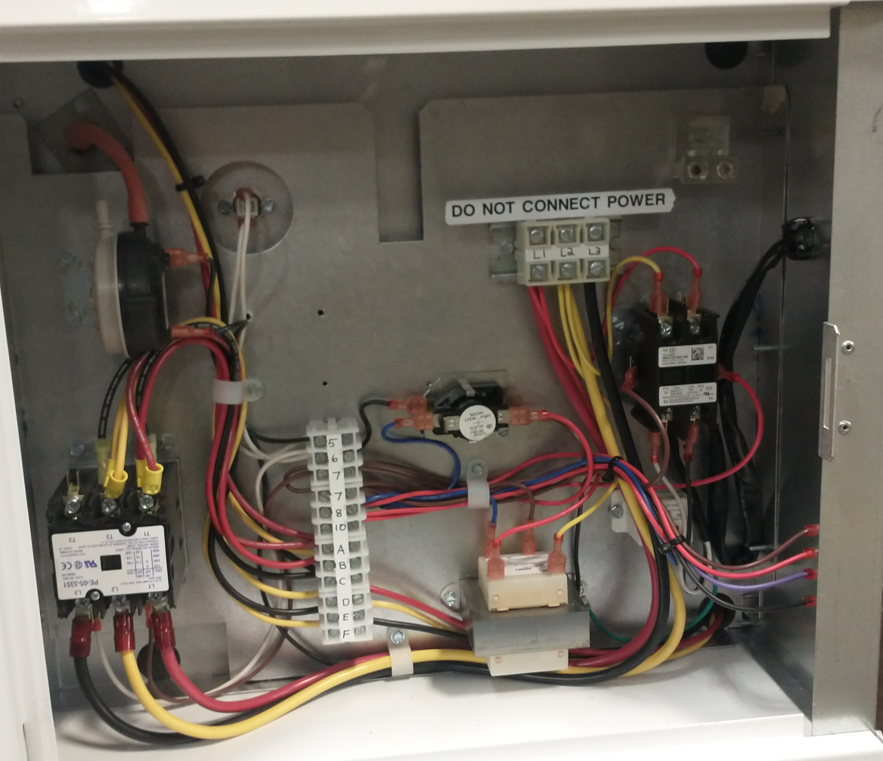
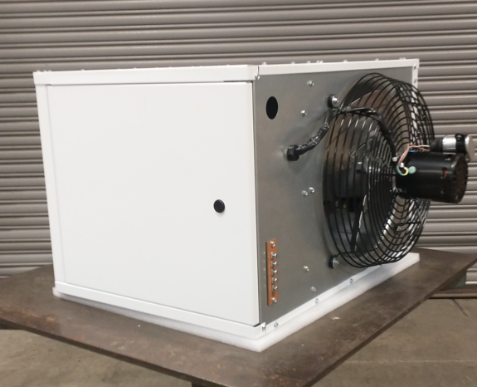
Product Design Review
Matt
2 Cabinet sizes for Optimization
  3-10 models
  15-30 models
Stainless Steel Sheathed and Finned Heating Elements
  Stainless Steel drives Reliability via corrosion resistance
    Not all vendors use SS for entire external construction
  Safety first: Electrical connections enclosed, sheath is non-energized
  Utilize only 4 capacities of elements to enable full range while driving supply chain efficiency
Safeties
  Automatic Reset Thermal Overload Protection on Fan Motor
  Automatic Reset High Temperature Limit Switch
  Air-flow Proving Switch

Slide 6
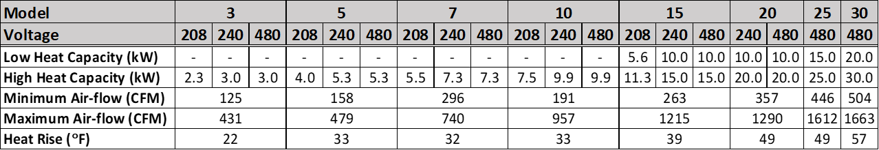
Performance Results
Matt
208V Capacity is 25% derate compared to 240V
230V = 240V Capacity

Slide 7
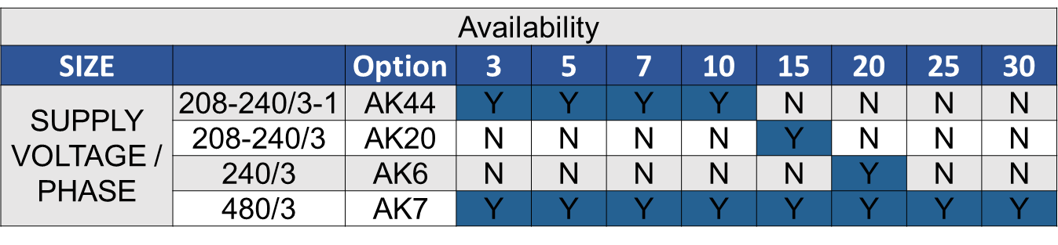
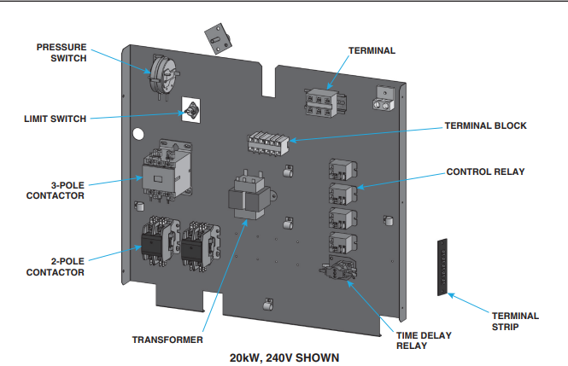
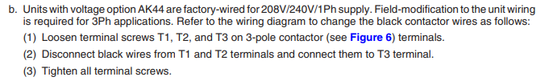
Voltage Availability
Designed for Availability
  208-240V/3-1 phase
    Incorporates all 4 variants
    208V is a derate of 240V
    Factory set 1 phase
    3 Phase Selection accomplished simply in field
  480V/3 ph available in all sizes
  Model 15-30are 3 phase only
  Larger Sizes in Larger Voltages to minimize amperage requirements
Developing:
  600V/3 ph for 15-30 kW models
  277V/1 ph for 3-10 kW models
  June 2024 Launch

Slide 8
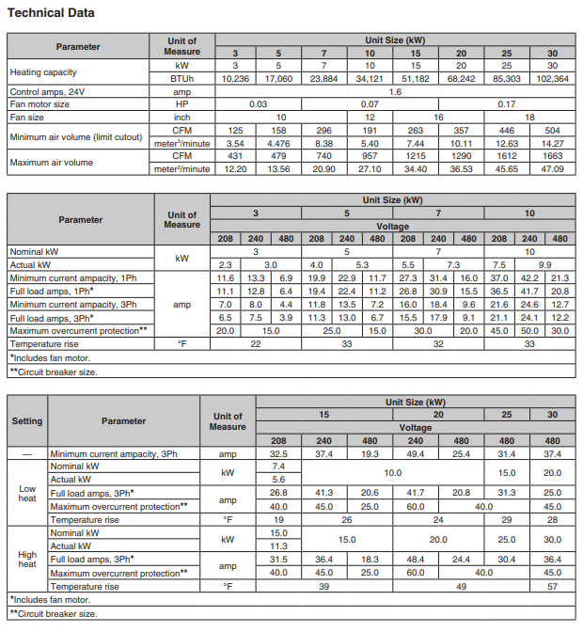
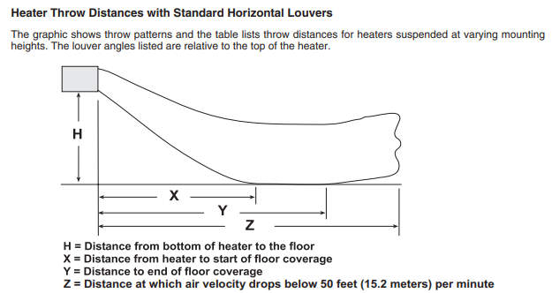
Tech Data
See EUH-TSL
Full Electrical Information
  FLA, MCA, MOP
  Disconnect/Circuit Breaker Size
Heater Throw Data
  Similar to Gas UH

Slide 9
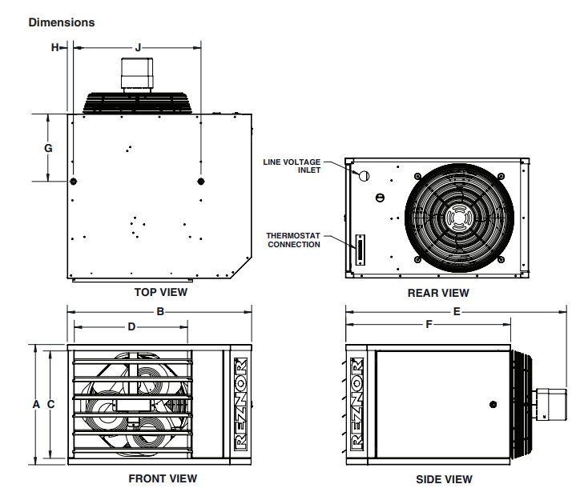
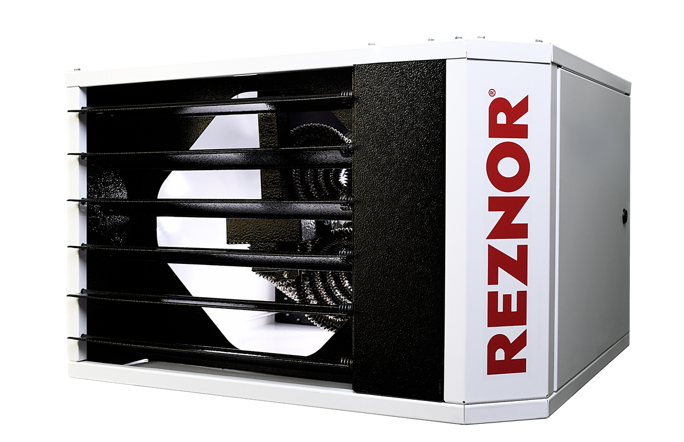
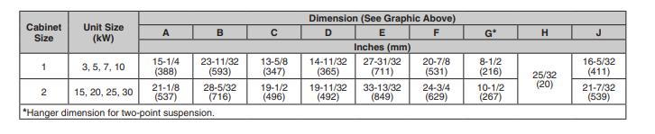
Dimension
Similar to smaller Gas UH
  Standardize to Reznor Look
  Reznor Robust Design Criteria
Standardize Parts with Gas UH
  Easier to Run in Plant
  Easier to Service in Field

Slide 10
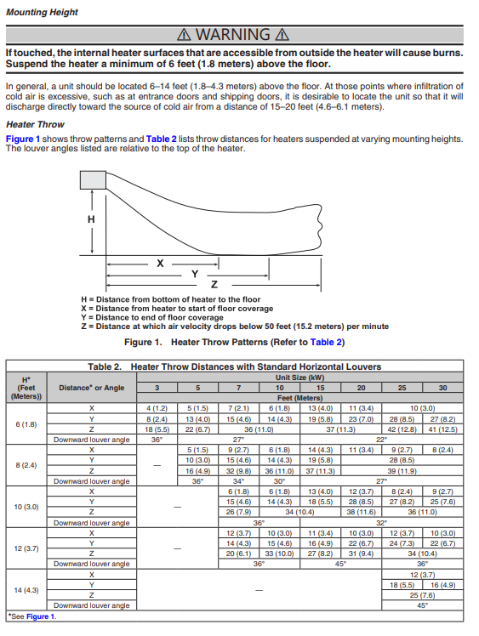
Air Throw Data
Full set of throw data available
Not commonly available in electric heating units

Slide 11
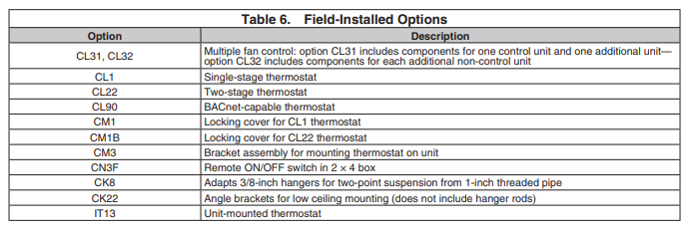
Option Review
Factory Installed Options
  Voltage Selection
  BA6 Factory installed disconnect
Large selection of Field Installed Option
  Many Controls Options Available
  Multiple Mounting Options if wall mounting is not desired

Slide 12
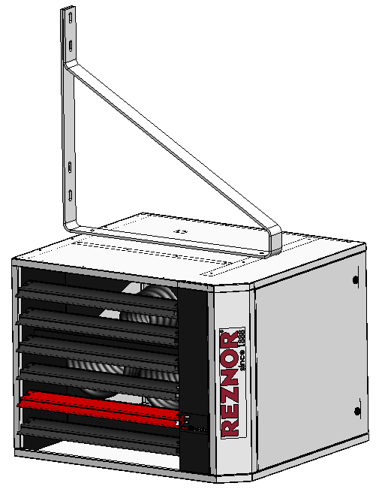
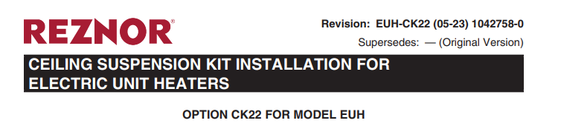
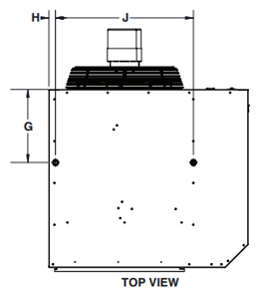
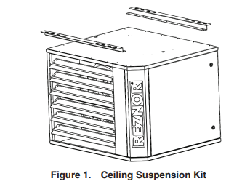
Hanging Options
  2-pt Ceiling Hanging
  Same to Gas-fired UH
    Uses 3/8” threaded rod std.
    1” pipe option (CK8)
    Verified level installation
  Wall Hangers
  Still being finalized
  Provided with unit
  Connects to 2-point hanging points
  Low Ceiling Hanger
  CK22
  Same as Gas-fired UH

Slide 13
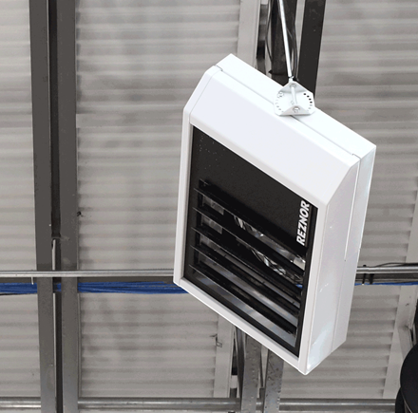
CONTROLS
Thermostat Call for Heat
Unit turns on Fan to mix space air
Temperature is not satisfied
Turn on heating elements
Thermostat satisfied
Turns off both heat and fan
Possible 2 Stage Operation
Control Options:
  On/Off Switch
  Wall Thermostat
    Fan Switch
  Unit Mounted Thermostat
    IT13
      CL1 and CM3 Bundle
  2 Stage T-stat Control
  With Unit Heater
  CL31 & CL 32 Multi-unit Control
    Up To 5 Units
    Potentially mix with other Reznor Products
  CL90 BACnet Control Thermostat
Also Possible to Stage Control with Reznor Huracan™ Destratification Fans

Slide 14
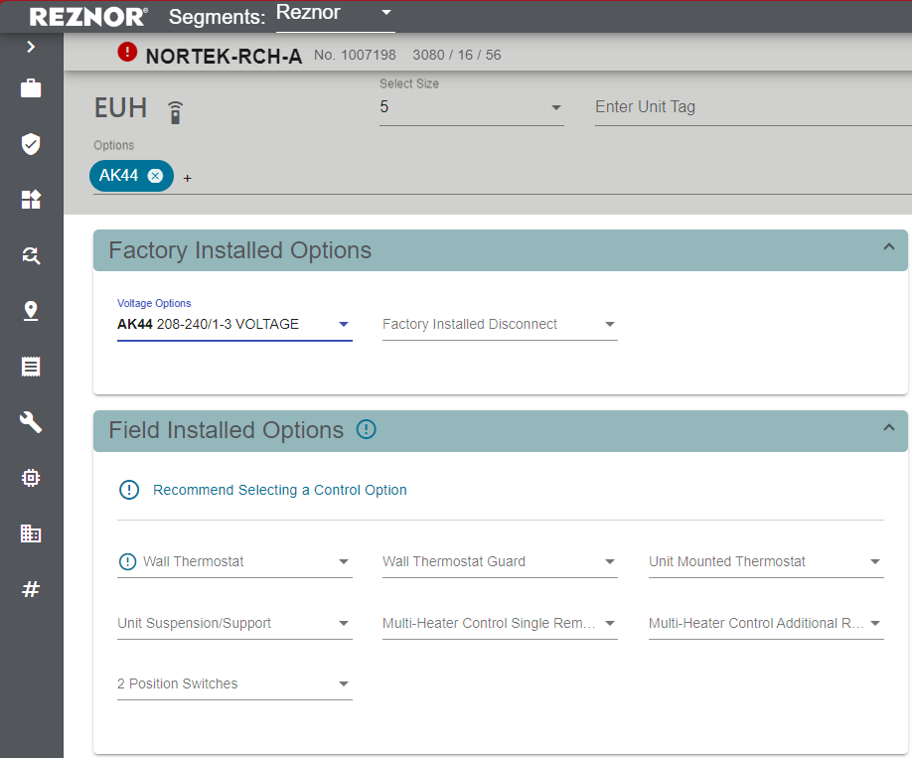
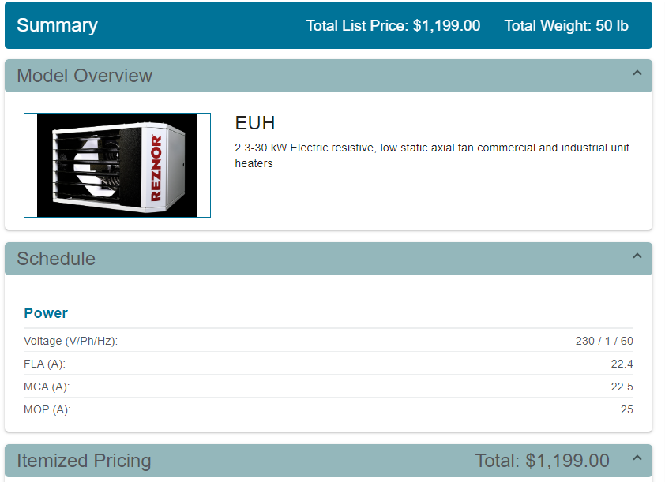
ACE Information During Selection
ACE Provides Electrical Data
For Multi-voltage units
  ACE shows factory voltage setting
  Nameplate provides data for each voltage so correct breaker, wiring, etc. can be field supplied.
  Same data as supplied within the submittal

Slide 15

Industry-best Availability
Lead-time: 15 working days
  Same as Reznor gas-fired unit heaters
  Enables inventory reduction and savings
  Typical competitor lead-time 8-12 weeks

Slide 16
Conclusion
EUH offers a standard range of electric unit heaters in most common voltages with more being developed
Consolidated voltages into a single unit reduces complexity, enabling sku and stocking savings with reduced selection effort
24V controls to enable usage with simple or enhanced thermostats
Multi-unit control and other enhanced control options to optimizespace energy efficiency
Sleek, modern, attractive design built Reznor Robust™
Industry-best 15 day lead-time to ship new orders

