Slide 1
Gas Unit Heater Portfolio
Updated January 2024

Slide 2
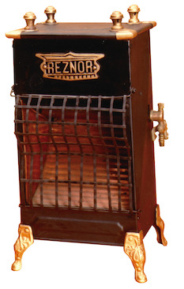
About REZNOR
135 Years of Heating Excellence
®
Founded in 1888 in Mercer, Pennsylvania
First Gas-fired Unit Heater in 1920
Acquired by Nortek Global HVAC in 2014
Industry Leaders in Unit Heater Innovation
1st Suspended Gas-fired Unit Heater
1st High Efficiency Models
1st Separated Combustion Models
The Original REZNOR Reflector Heater

Slide 3
Fast and Easy to Install
External Gas Connection
External Vent Connections
External Thermostat Connections
Built in Disconnect Switch in Separated Combustion models
2 or 4-post Hanging
Low Profile Hangers
Adaptable to 1” pipe-hanging
Easy Access to Manual with QR code
Multiple Languages
Many Venting Options Available

Slide 4
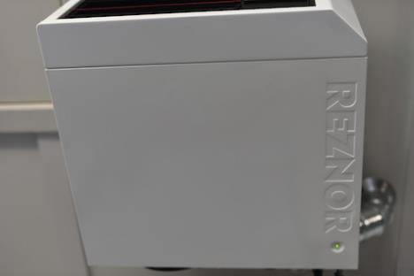
External Status Indicating LED
Normal Operation Indicated by Solid Green Light
Flashing Green Light Indicates a Fault and Service is Required
Visually Notifies owner of Issues

Slide 5
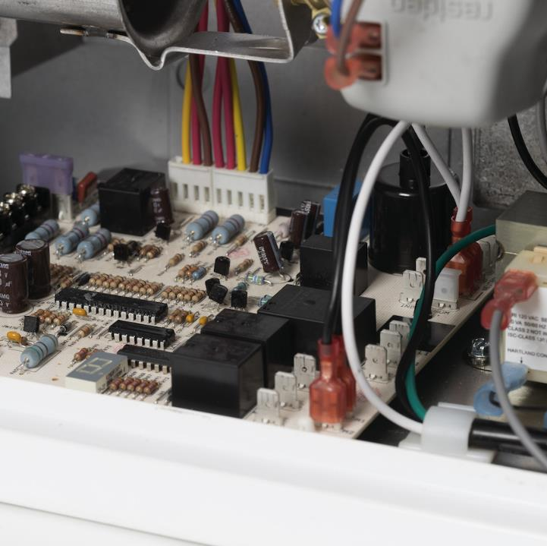
Digital Error Code Display
Quick and Easy Troubleshooting
Alphanumeric Digital Display (no more counting flash codes)
Minimizes Unit Downtime by Providing the Repair Technician the Exact Fault Information
Inside door has all fault codes listed on wiring diagram

Slide 6
Fast and Easy to Maintain or Service
Easy Access Service Door
Door is Hinged and Removable
Door has Safety Strap
Built-in Disconnect Switch on Separated Combustion Models
Error Code Display
Easy Access to Manual and Repair Parts List with QR code
1400+ Reznor-qualified Branches for Service Parts
Operation Verification
At-a-Glance
Local Technical Support

Slide 7
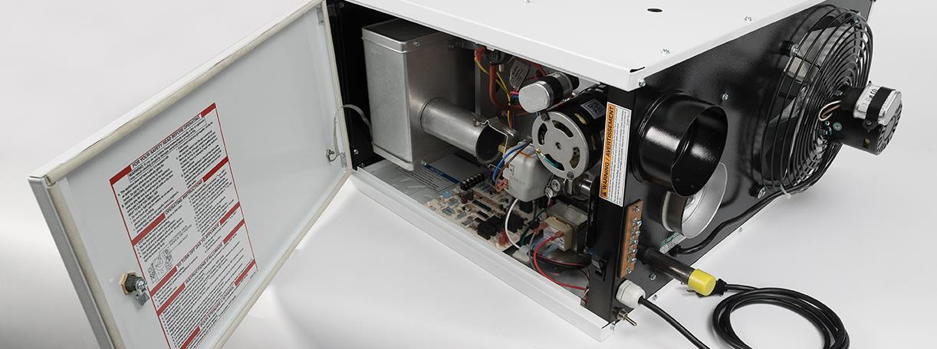
Hinged Service Door
EASIER, FASTER, SAFER
Easy Screwdriver ¼ Turn Latch​
Hinged Design for Rapid Access
Completely Removeable for Service in Tight Spaces​
Safety Strap Attaches Door to Unit so it CAN’T Fall

Slide 8
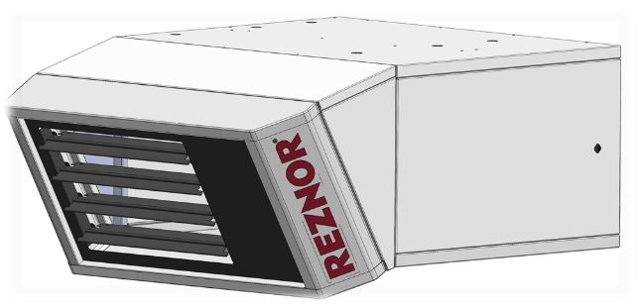
Flexibility to Move Heat Where Needed
Easily added Downturn Nozzles for partial vertical throw
30° or 60° downturn
Horizontal Louvers standard
Vertical Louvers optional

Slide 9
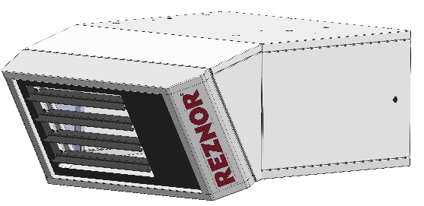
Integrated Downturn Nozzle
Improved Heat Distribution Control
Nozzle Throws Heat towards Floor Closer to the Unit
Seamless Integration for High-quality Appearance​
Downturn Capabilities​
30°
60°
Simply-installed
Modular Design

Slide 10
Professional Modern Styling
Unique, Smooth, Appliance-quality Appearance
Hidden Edges And Fasteners
Contrasting-color and Recessed Front Plate
Signature “REZNOR” Bevel
Optional Parts Seamlessly Integrate into the Cabinet
Contrasting Red Louver
and Raised REZNOR Logo*
Embossed REZNOR Logo Underneath and Viewable from Floor*
*on premium models

Slide 11
Current REZNOR Product Offering
UBX
UBZ
UEZ
UDX
UDZ

Slide 12
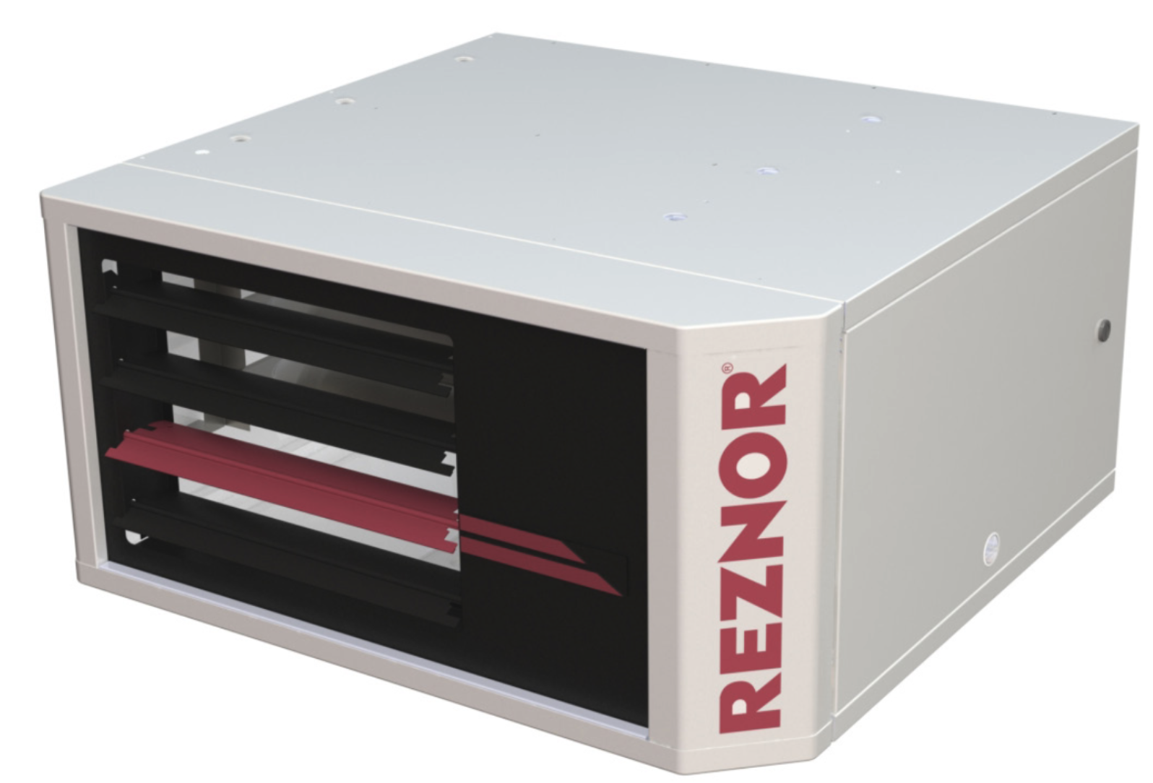
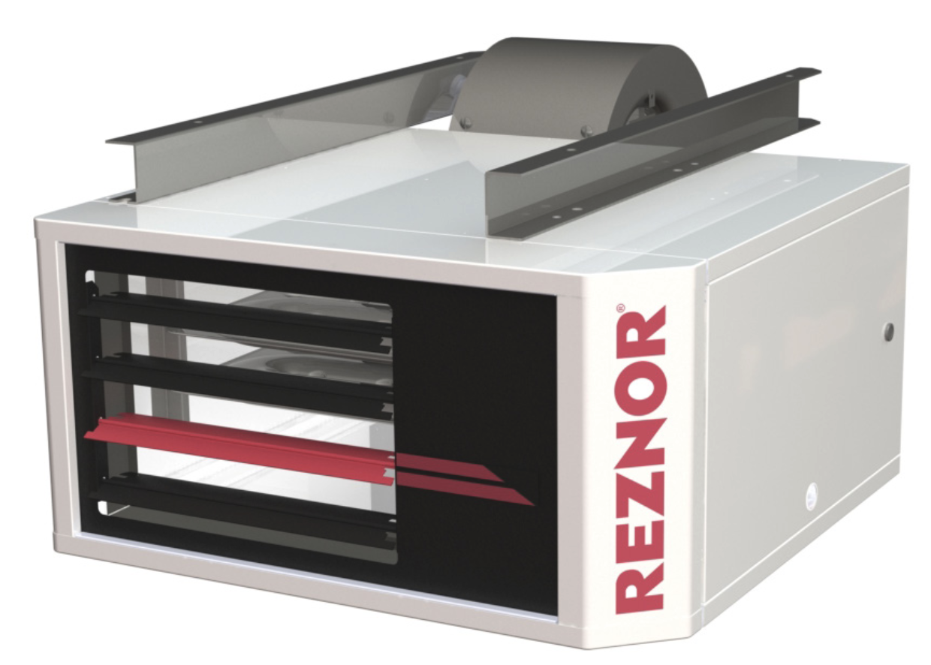
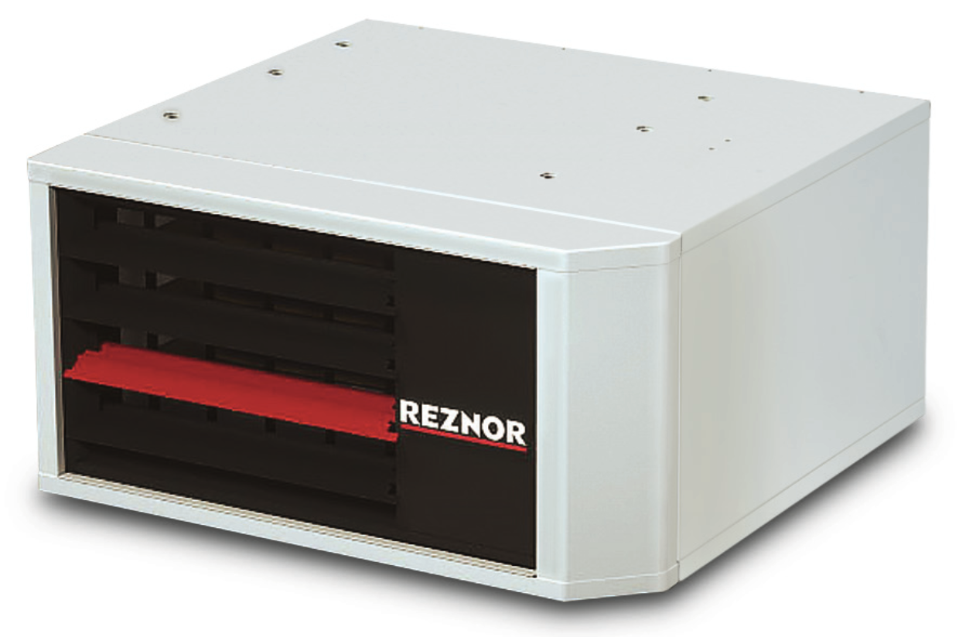
Future Unit Heater Product Line-Up
Model | Application | Thermal Efficiency | Capacity | Warranty
UDXC | Power Vented Standard (Optional Separated Combustion) | 82-83% | 14 Capacities from 30-400 MBH | 5 Years Parts & 10 Year Heat Exchanger Warranty
UBXC | Power Vented Standard (Optional Separated Combustion) | 82-83% | 14 Capacities from 30-400 MBH
UEZ | Separated Combustion | 91-93% | 7 Capacities from 55 - 310 MBH
Model UDXC
Models UBXC
Model UEZ

Slide 13
Nomenclature | Designation
U | Unit Heater
D | 82-83% Thermal Efficient with Axial Fan
X | Standard Combustion
C | Standard or Separated Combustion Capable
E | 93% Thermal Efficient with Axial Fan
B | 82-83% Thermal Efficient with Blower Fan
Z | Separated Combustion

Slide 14
Unit Heater Simplification
NEW UDXC & UBXC Separated Combustion Capable
Simple Field Conversion with Available Kit
UDXC Replaces UDX and UDZ in Reznor Portfolio
UBXC Replaces UBX and UBZ in Reznor Portfolio
UEZ High Efficiency Condensing
91-93% Efficient
Recently expanded to cover residential opportunities
55, 85, 110, 130, 180, 260, & 310 MBH models
UEZ

Slide 15
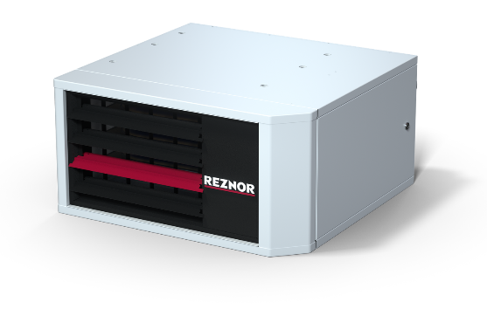
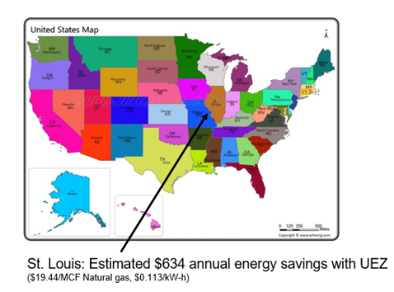
UEZ
High Efficiency Reduces Energy Use & Operating Costs
Often < 2-year Payback
Up to 93% Thermal Efficiency
Separated Combustion
Eliminates Warm Air Losses through Combustion
7 Sizes, 55-310 MBH, Including 3 NEW Sizes
55, 85, 110
All are Rated for Industrial/Commercial heating
55-110 are also Rated for Residential Non-living Space Heating
MacroChannel® Secondary Heat Exchanger on High Airflow Models for Reduced Cleaning
Notes:
We are currently developing lower capacities for this model, but a timetable hasn’t been finalized yet.

Slide 16
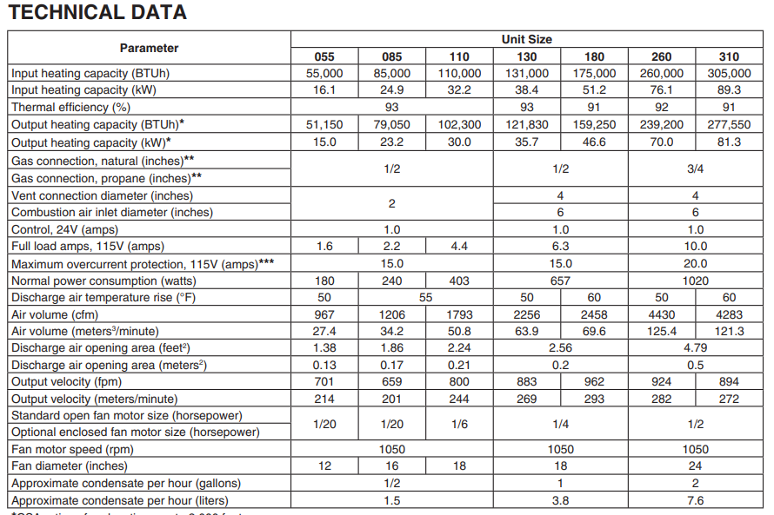
UEZ Key Technical Specifications
7 Capacities
55,000-310,000 Btu/h
55-110 Models Residential Cert.
91-93% Thermal Efficiency
50-60°F Air Temperature Rise
967-4,283 CFM using an Axial Fan
24V Control
180-1,020 Watts Electrical Power Consumption

Slide 17
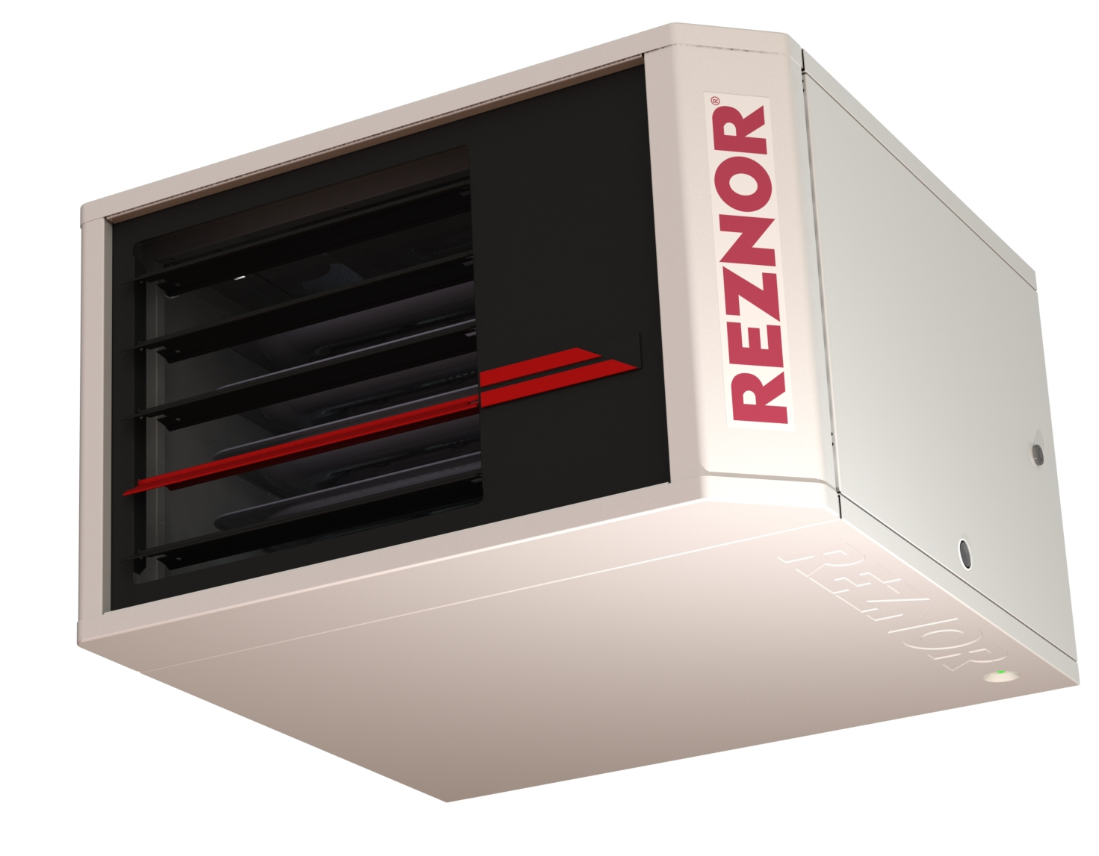
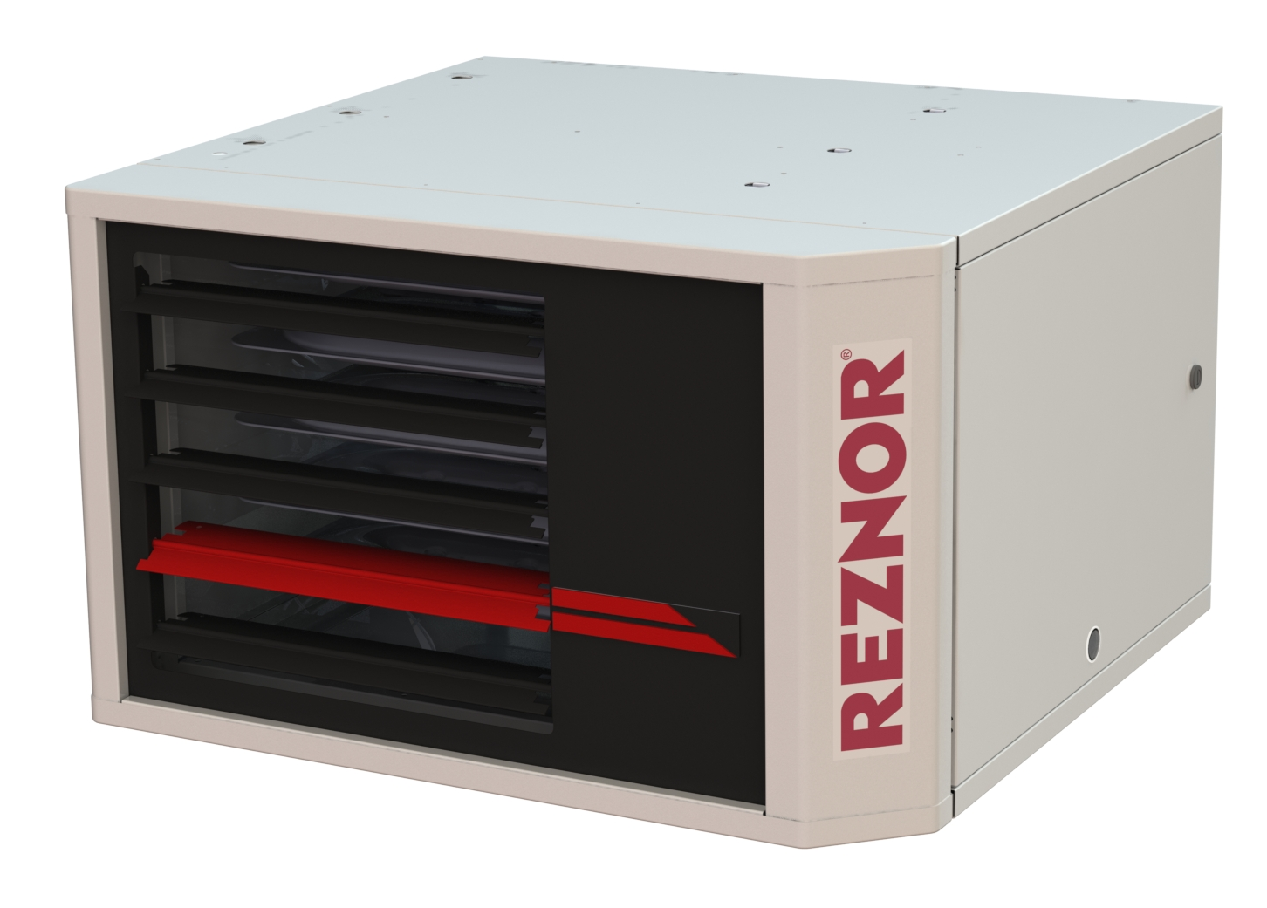
UDXC/UBXC
82-83% Thermal Efficiency
30,000-400,000 Btuh in 14 Sizes
Field Convertible for Separated Combustion (Option SC1 – Separated Combustion Kit)
LP Kits for all Propane Unit Heater Applications will now be field installed
UDXC/UBXC Sizes 30-400 Btuh Certified for Commercial/Industrial Heating Applications
UDXC Sizes 30-125 Btuh Approved for use in Residential Garages and Workshops
UBXC Satisfies High Airflow Needs in Commercial/Industrial Applications
Higher CFM & Increased Static Capable
Longer Throw or Duct Capable
\Many Motor/Blower Options for the Optimal Solution

Slide 18
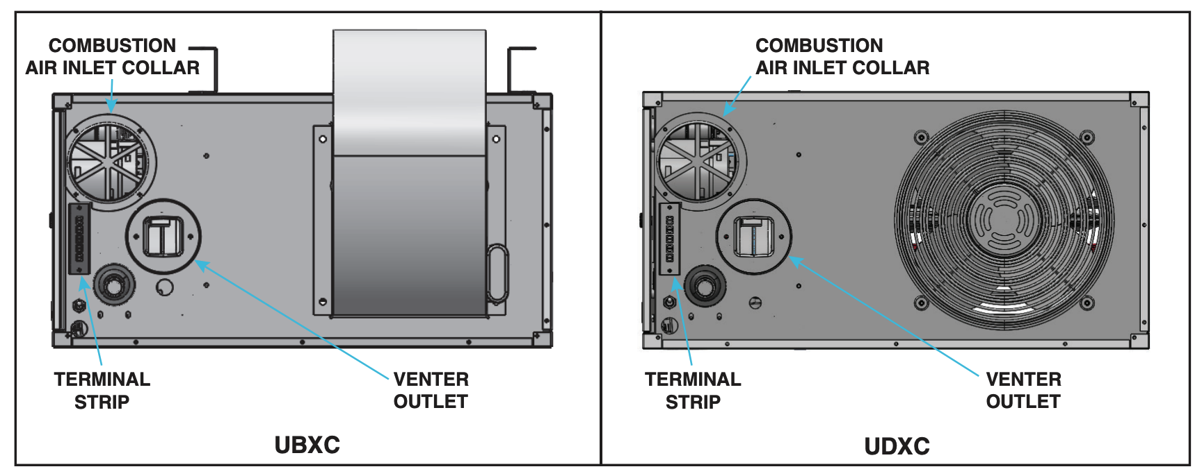
UDXC/UBXC – SC1 Separated Combustion Kit
SC1 Optional Kit
Converts a UDX-C or UBX-C unit from a Power Vented Unit to a Separated Combustion Unit in the field
The SC1 Kit includes door seal, door switch, vent adapter gasket & collar for the combustion air inlet of unit
Separated Combustion unit heaters require the use of a CC2 Vertical Vent Kit or CC6 Horizontal Vent Kit

Slide 19
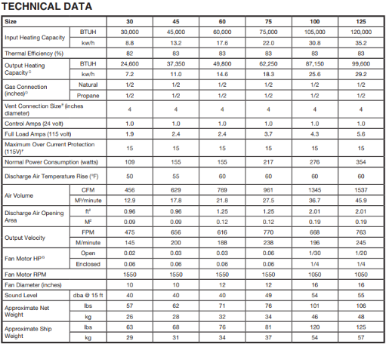
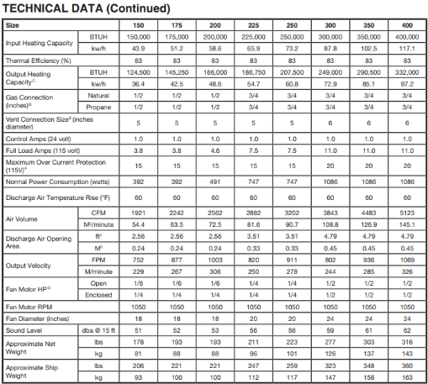
UDXC Key Technical Specifications
14 Capacities
30,000-400,000 Btu/h
82-83% Thermal Efficiency
50-60°F Air Temperature Rise
456-5,123 CFM Using Axial Fan
24V Control with Common Terminal
109-1,086 Watts Electrical Power Consumption

Slide 20
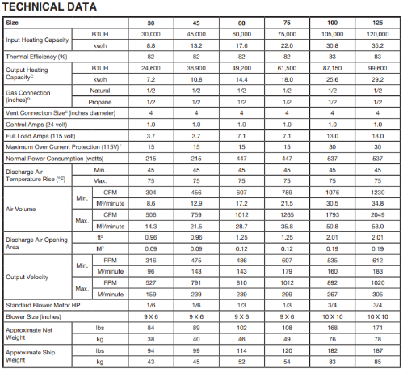
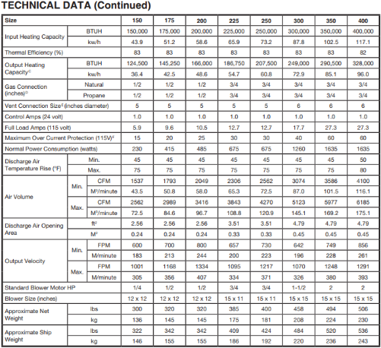
UBXC Key Technical Specifications
14 Capacities
30,000-400,000 Btu/h
82-83% Thermal Efficiency
45-80°F Air Temperature Rise
304-6,185 CFM Using Belt-drive Blower Fan
24V Control with Common Terminal
215-1,635 Watts Electrical Power Consumption

Slide 21
Highly Customizable Controls
Single or 2 stage gas heating
Control type options:
Single stage Wall Thermostat
Standard temperature control
Programmable and Wi-Fi-enabled stats available
2-stage T-stat control
Using 2 stage thermostat
1st stage fan starts
2nd stage unit heaters start
Multi-unit control
Control up to 5 units with single thermostat
Option CL 31
enables 4 additional remote units which are option CL32
Turn on Heating
Stage 1
UH Fan on
T_{actual} < T_{SET}
Stage 2 kicks Gas Heat on
T_{actual} < T_{SET}
Stage 1 off
Stage 2 off
2 Stage T-stat Control Flowchart
T_{actual} = T_{SET}

Slide 22
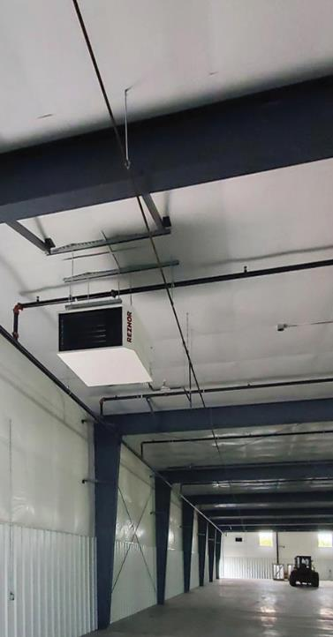
Tailored Performance for All Needs
High Efficiency Condensing Models
14 Capacities with 82-83% Models
Field Convertible to Separated Combustion
Utilizes Outside Air for Combustion for Safety
Economically & Precisely Heat the Space
Up to 93% Thermal Efficiency for Long-term Energy Savings
Distribute Heat Evenly with More Lower Capacity Units
Reduces Heat Losses for Building Energy Conservation
Fan-only Operation for Air Circulation with 2-stage Tstat
Multiple Unit Control Options
Use for Harsh Environments or where you need outside air for combustion

Slide 23
REZNOR Makes Your Choice Simple
Unique Features
High Performance Benefits
Easy to Install
Easy Access to Connections
Easy Access to Documentation
Multiple Unit Control
Easy to Maintain/Service
Quick & Easy to Access Controls
Easy to Troubleshoot
Clean, Professional Look
Smooth Modern Design Features
Integrated Options
Reduced Installation Cost
Reduced Installation Materials
Reduced Installation Errors
Reduced Downtime
Reduced Service Costs
Reduced Service Error
Reduced Safety Incidents
Increased Owner Satisfaction
Increased Contractor Reputation

Slide 24
REZNOR Advantages
Warranty
10-year heat exchanger warranty
5-year electrical & mechanical parts
Non-prorated warranty for residential and commercial installations
Registration of warranty is not required
Other Advantages
Highest efficiency unit heaters in its class 82-83% or 93% thermal efficiency
Wi-Fi thermostat compatible with standard C-Terminal.
Aesthetically pleasing modern cabinet design.

Slide 25
Thank You!

